Slide 1
Advanced DML Statements
<Trainer-Name>

Slide 2
Agenda
JOINs in SQL Server
Subquery
Common Table Expressions(CTE)
Ranking functions
SQL code practices

Slide 3
Overview
JOINs: Retrieve data from two or more tables based on logical relationships between the tables:
Inner Join
Outer Join
Cross Join
Self Join
Subquery: A query that is nested inside a SELECT, INSERT, UPDATE, or DELETE statement, or inside another sub-query
Ranking functions:
Row_Number
Rank
Dense_Rank
Ntitle

Slide 4
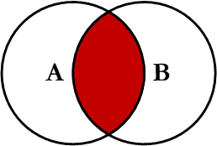
JOINs in SQL Server INNER JOIN
Return all of the records in the left table (table A) that have a matching record in the right table (table B)
Eliminate the rows that do not match with a row from the other table
Syntax
SELECT col_names
FROM Table_A A
INNER JOIN Table_B B
ON A.Col1 = B.Col1

Slide 5
JOINs in SQL Server INNER JOIN Demo
Demo
Notes:
See “INNER JOIN” in Day1_Demo.docx

Slide 6
JOINs in SQL Server OUTER JOIN
Outer Join: Return all rows from at least one of the tables mentioned in the FROM clause, as long as those rows meet any WHERE or HAVING search conditions:
LEFT OUTER JOIN (or LEFT JOIN)
RIGHT OUTER JOIN (or RIGHT JOIN)
FULL OUTER JOIN (or FULL JOIN)

Slide 7
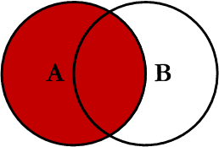
JOINs in SQL Server LEFT OUTER JOIN
Return all of the records in the left table (table A) regardless if any of those records have a match in the right table (table B)
In the results where there is no matching condition, the row contains NULL values for the right table’s columns.
Syntax
SELECT col_names
FROM Table_A A
LEFT JOIN Table_B B
ON A.Col1 = B.Col1

Slide 8
JOINs in SQL Server LEFT OUTER JOIN Demo
Demo
Notes:
See “LEFT JOIN” in Day1_Demo.docx

Slide 9
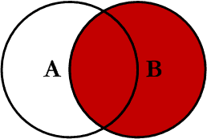
JOINs in SQL Server RIGHT OUTER JOIN
Return all of the records in the right table (table B) regardless if any of those records have a match in the left table (table A)
In the results where there is no matching condition, the row contains NULL values for the left table’s columns.
Syntax
SELECT col_names
FROM Table_A A
RIGHT JOIN Table_B B
ON A.Col1 = B.Col1

Slide 10
JOINs in SQL Server RIGHT OUTER JOIN Demo
Demo
Notes:
See “RIGHT JOIN” in Day1_Demo.docx

Slide 11
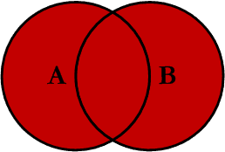
JOINs in SQL Server FULL OUTER JOIN
Return all of the records from both tables, joining records from the left table (table A) that match records from the right table (table B)
Syntax
SELECT col_names
FROM Table_A A
FULL JOIN Table_B B
ON A.Col1 = B.Col1

Slide 12
JOINs in SQL Server FULL OUTER JOIN Demo
Demo
Notes:
See “FULL JOIN” in Day1_Demo.docx

Slide 13
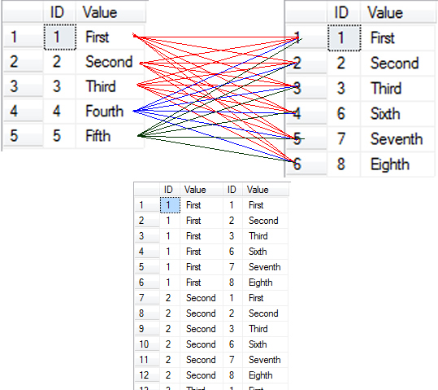
JOINs in SQL Server CROSS JOIN
Return records that are multiplication of record number from both the tables
Does not need any condition to join
Syntax:
SELECT col_names
FROM Table_A A
CROSS JOIN Table_B B

Slide 14
JOINs in SQL Server CROSS JOIN Demo
Demo
Notes:
See “CROSS JOIN” in Day1_Demo.docx

Slide 15
JOINs in SQL Server Self JOIN
A SELF JOIN is a join of a table to itself. In SELF JOIN, we can use:
INNER JOIN
OUTER JOIN
CROSS JOIN

Slide 16
JOINs in SQL Server SELF JOIN Demo
Demo
Notes:
See “Seft Join” in Day1_Demo.docx

Slide 17
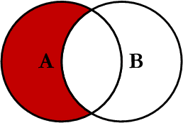
JOINs in SQL Server LEFT Excluding JOIN
Return all of the records in the left table (table A) that do not match any records in the right table (table B)
Syntax
SELECT col_names
FROM Table_A A
LEFT JOIN Table_B B
ON A.Col1 = B.Col1
WHERE B.Col1 IS NULL

Slide 18
JOINs in SQL Server LEFT Excluding JOIN Demo
Demo
Notes:
See “LEFT Excluding JOIN” in Day1_Demo.docx

Slide 19
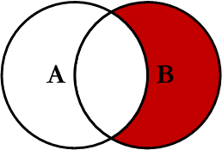
JOINs in SQL Server RIGHT Excluding JOIN
Returns records in the right table (table B) that do not match any records in the left table (table A)
Syntax
SELECT col_names
FROM Table_A A
RIGHT JOIN Table_B B
ON A.Col1 = B.Col1
WHERE A.Col1 IS NULL

Slide 20
JOINs in SQL Server RIGHT Excluding JOIN Demo
Demo
Notes:
See Day1_Demo.docx

Slide 21
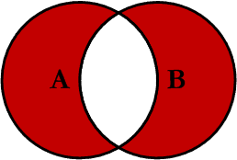
JOINs in SQL Server OUTER JOIN EXCLUDING JOIN
Return all of the records in the left table (table A) and all of the records in the right table (table B) that do not match
Syntax
SELECT col_names
FROM Table_A A
RIGHT JOIN Table_B B
ON A.Col1 = B.Col1
WHERE A.Col1 IS NULL OR B.Col1 IS NULL

Slide 22
JOINs in SQL Server OUTER JOIN EXCLUDING JOIN Demo
Demo
Notes:
See “OUTER JOIN EXCLUDING JOIN” in Day1_Demo.docx

Slide 23
JOINs in SQL Server Joining Three or More Tables
Due to FROM clauses can contain multiple join specifications so this allows many tables to be joined for a single query
Example
SELECT col_names
FROM Table_A A
JOIN Table_B B
ON A.Col1 = B.Col1
LEFT JOIN Table_C C
ON B.Col2 = C.Col2
….

Slide 24
JOINs in SQL Server Joining Three or More Tables Demo
Demo
Notes:
See Day1_Demo.docx

Slide 25
Subquery
Subquery: Is a query that is nested inside a SELECT, INSERT, UPDATE, or DELETE statement, or inside another sub-query
Inner query is independent of outer query.
Inner query is executed first and the results are stored.
Outer query then runs on the stored results.

Slide 26
Subquery Subquery Types
We focus on some types of Subquery:
Subqueries with Aliases
Many statements in which the subquery and the outer query refer to the same table
Subqueries with IN / NOT IN
The result of a subquery introduced with IN (or with NOT IN) is a list of zero or more values. After the subquery returns results, the outer query makes use of them
Subqueries in UPDATE, DELETE, INSERT, SELECT
Subqueries with EXISTS / NOT EXISTS
The subquery functions as an existence test.

Slide 27
Subquery Subquery Types Demo
Demo
Subqueries with Aliases
Subqueries with IN / NOT IN
Subqueries in UPDATE, DELETE, INSERT, SELECT
Subqueries with EXISTS / NOT EXISTS
Notes:
See “Subquery” in Day1_Demo.docx

Slide 28
Common Table Expressions
A CTE can be thought of as a temporary result set that is defined within the execution scope of a single SELECT, INSERT, UPDATE, DELETE. It can be used:
Create a recursive query
As a temporary table.
Syntax
; WITH CTE_Name [ col_names]
AS
(
CTE_query_definition
)

Slide 29
Common Table Expressions Recursive
Recursive Queries Using Common Table Expressions
Syntax:
WITH cte_name ( col_names)
AS
(
CTE_query_definition -- Anchor member is defined.
UNION ALL
CTE_query_definition -- Recursive member is defined referencing cte_name.
)
-- Statement using the CTE
SELECT *
FROM cte_name

Slide 30
Common Table Expressions Common Table Expressions Demo
Demo
Notes:
See “Common Table Expressions” in Day1_Demo.docx

Slide 31
Ranking functions
Ranking functions: Ranking functions provides the ability to rank each row of data.
Row_Number: Returns the sequential number of a row within a partition of a result set
Rank: Returns the rank of each row within the partition of a result set
Dense_Rank: Returns the rank of rows within the partition of a result set, without any gaps in the ranking
Ntitle: Distributes the rows in an ordered partition into a specified number of groups

Slide 32
Ranking functions Demo
Demo
Row_Number
Rank
Dense_Rank
NTitle
Notes:
See “Ranking functions” in Day1_Demo.docx

Slide 33
SQL Code Practice
Explicitly Name Columns in SELECT Statements
Improve performance.
Prevent potential failures related to some database schema change in the future.
For example, using:
SELECT EmployeeID, FirstName, LastName FROM dbo.Employee
Instead of:
SELECT * FROM dbo.Employee

Slide 34
SQL Code Practice
Explicitly Name Columns in INSERT Statements
Prevent potential failures related to some database schema change in the future.
Prevent error with identity column
For example, using:
INSERT dbo.Employee (FirstName, LastName, NationalIDNumber, ManagerID, Title, BirthDate, MaritalStatus, Gender)
VALUES ('Bill', 'Gates', '123456', NULL, 'CEO', '1959-01-01', 'M' , 'M')
Instead of :
INSERT dbo.Employee
VALUES ('Bill', 'Gates', '123456', NULL, 'CEO', '1959-01-01', 'M' , 'M')

Slide 35
SQL Code Practice
Always specific schema for tables in query.
Prevent potential failures related to some database schema change or permission change on schema in the future.
SELECT A.Key1 , B.Col1 , C.Col2
FROM dbo.TableA A
INNER JOIN dbo.TableB B
ON A.Key1 = B.Key1
INNER JOIN dbo.TableC C
ON A.Key1 = C.Key1
WHERE A.Col1 = '123'
AND B.Col2 like 'A%‘
SELECT A.Key1 , B.Col1 , C.Col2
FROM TableA A
INNER JOIN TableB B
ON A.Key1 = B.Key1
INNER JOIN TableC C
ON A.Key1 = C.Key1
WHERE A.Col1 = '123'
AND B.Col2 like 'A%‘

Slide 36
SQL Code Practice
Always provides alias for tables in query.
Make query more clearer and easier to read.
SELECT A.Key1 , B.Col1 , C.Col2
FROM dbo.TableA A
INNER JOIN dbo.TableB B
ON A.Key1 = B.Key1
INNER JOIN dbo.TableC C
ON A.Key1 = C.Key1
WHERE A.Col1 = '123'
AND B.Col2 like 'A%‘
SELECT TableA.Key1 , TableB.Col1 , TableC.Col2
FROM dbo.TableA
INNER JOIN dbo.TableB
ON TableA.Key1 = TableB.Key1
INNER JOIN dbo.TableC
ON TableA.Key1 = TableC.Key1
WHERE TableA.Col1 = '123'
AND TableB.Col2 like 'A%‘

Slide 37
SQL Code Practice
Avoid SQL Server functions in the WHERE clause
Improve performance.
SELECT EmailAddress
FROM person.contact
WHERE EmailAddress like 'As%'
SELECT EmailAddress
FROM person.contact
WHERE left(EmailAddress,2) = 'As'
Notes:
See more detail in the “SQL Code Practice” in Day1_Demo.docx

Slide 38
SQL Code Practice
Only use DISTINCT if necessary
Only use UNION if necessary, in other case use UNION ALL

Slide 39
Q&A
How many JOINs in SQL Server?
Is there any different if we put condition at ON condition and WHERE condition of INNER JOIN?
Is there any different if we put condition at ON condition and WHERE condition of LEFT JOIN?
When should we use subquery instead of JOIN?

